Slide 1
Identifying Research Problem and Research Questions

Slide 2
Key Concepts
What is a research problem and why is it important?
Where do you find this “problem?”
How can you distinguish it from other “parts?”
Can and should the “problem” be researched?
How does the “problem” differ for quantitative and qualitative research?
What are the five elements that comprise the “statement of the problem” section?
How do you write this section into your research?

Slide 3
What is a Research Problem?
A research problem is an educational issue or concern that an investigator presents and justifies in a research study.

Slide 4
Why is the Research Problem Important?
Establishes importance of topic
Creates reader interest
Focuses reader’s attention on how study will add to literature

Slide 5
Where is the Research Problem Located?
Look in the opening paragraphs, and ask yourself:
What was the issue or problem that the researcher wanted to address?
What is the concern being addressed “behind” this study?
Why was the study undertaken in the first place?
Why is this study important?

Slide 6
How Does It Differ from Other Parts of Research?
A research problem is an educational issue or problem in the study
A research topic is the broad subject matter being addressed in a study.
A purpose is the major intent or objective of the study.
Research questions are questions the researcher would like answered or addressed in the study.

Slide 7
Differences Among Topic, Problem, Purpose and Questions
General
Topic
Distance Learning
Research
Problem
Lack of students in distance classes
Purpose
Statement
To study why students do not attend distance education classes at a community college.
Research
Question
Does the use of web site technology in the classroom deter students from enrolling in a distance education class?
Specific

Slide 8
Can and Should the Problem Be Researched?
Can you study the problem?
Do you have access to the research site?
Do you have the time, resources and skills to carry out the research?
Should you study the problem?
Does it advance knowledge?
Does it contribute to practice?

Slide 9
How Does the Research Problem Differ for Quantitative and Qualitative Research?
Use quantitative if your research problem requires you to
Measure Variables
Assess the impact of these variables on an outcome
Test theories or broad explanations
Apply results to a large number of people
Use qualitative if your research problem requires you to
Learn about the views of the people you plan to study
Assess a process over time
Generate theories based on participant perspectives
Obtain detailed information about a few people or research sites.

Slide 10
Five Elements of a “Problem Statement”
FLOW OF IDEAS
What
Remedying
the Deficiencies
will do for
Select
Audiences
Educational
Issue
Evidence for
the
Issue
Deficiencies
in the
Evidence
Topic
Subject
Area
A Concern
A Problem
Something
that needs a
solution
Evidence from
the literature
Evidence from
practical
experiences
In this body of
evidence, what is
missing?
What do we
need to know
more about?
How will addressing
what we need to
know help:
researchers
educators
policy makers
individuals like
those in the study

Slide 11
Advancing the Topic
Introduced in the first couple of paragraphs
The general subject matter
Needs to be introduced so that reader can relate to the topic

Slide 12
The First Sentence of the Topic
The narrative hook
The narrative hook performs the following functions:
Causes the reader to pay attention
Elicits an emotional or attitudinal response from the reader
Causes the reader to continue reading

Slide 13
Stating the Research Problem
State in opening paragraph
Identify an issue
Research-based research problems
Practical problems
Reference the problem using the literature

Slide 14
Justifying the Importance of the Research Problem
Justification based on what other researchers have found
Justification based on personal or workplace experiences

Slide 15
Identifying Deficiencies in the Evidence
What do we still need to know?
What else do we need to know to improve practice?

Slide 16
Identify the Audience
Who will profit from reading our study?
Other researchers
Practitioners
Policy makers
Special populations (e.g. parents)

Slide 17
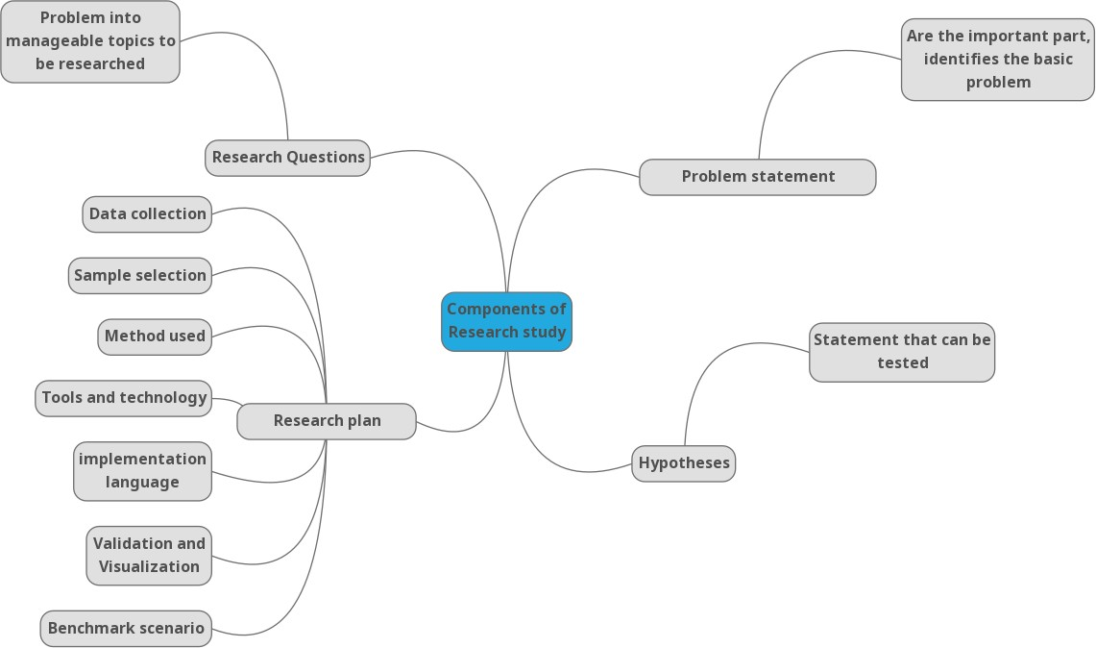
Components of research study
17

Slide 18
How Do We Write the “Statement of the Problem” Section?
One paragraph for each of the five elements
Heavily reference this section to the literature
Provide statistics to support trends
Use quotes from participants (in moderation)

Slide 19
Problem statement
Most students believe that programming is a difficult subject to understand and score a good mark. Learning programming is boring and difficult if students are not interested in the subject. Students’ learning style is also different for each student, some like discussion with friends while other prefers to study alone (Masura R. et al, 2012). Most of the novice programmer feel shy to ask questions again and again in front of the whole class. As a result they remained stuck or give up solving the problem.
RQ-1 What are the strategies and patterns novice programmers use while solving a problem?
RQ-2 How gamification approach differs from the conventional approach in case of understanding programmers behavior ?
RQ-3 What are the difficulties novice programmers face while solving problem?
RQ-4 What strategies can novice programmers adopt to improve their ability to solve problem?
Masura Rahmat , Shahrina Shahrani, Rodziah Latih, Noor Faezah Mohd Yatim, Noor Faridatul Ainun Zainal & Rohizah Ab Rahman. (2012). Major problems in basic programming that influence student performance . Procedia - Social and Behavioral Sciences 59 ( 2012 ) 287 – 296
12

Slide 20

Research questions
It has been observed that among the failed students, majority of students are coming from the programming related courses [Observation]
It has been observed that among failed students, majority of students are coming from programming related courses [Observation]
Research questions!
Why did students fail in programming class?
What is the ratio of male and female students.......?
Research Questions
20

Slide 21
What are research Questions?
Research questions -- that researcher would like to answer in the study.
Questions around which you center your research.
Should be:
clear: it provides enough specifics that one’s audience can easily understand its purpose without needing additional explanation.
focused: it is narrow enough that it can be answered thoroughly
concise: it is expressed in the fewest possible words.
complex: it is not answerable with a simple “yes” or “no” but rather requires synthesis and
analysis of ideas and sources prior to composition of an answer.
https://writingcenter.gmu.edu/guides/how-to-write-a-research-question
7

Slide 22
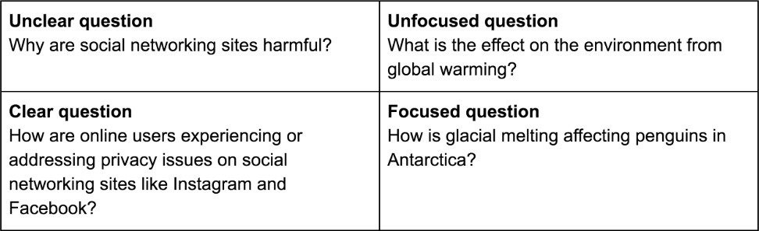
What are research Questions?

Slide 23
Examples: Good and bad research questions
Why do some students perform better than other in grade 12 examinations?
What strategies improve students understanding of main ideas in English comprehension tests?

Slide 24
Examples: Good and bad research questions
Why do some students perform better than other in grade 12 examinations?
What strategies improve students understanding of main ideas in English comprehension tests?
Do students in private schools perform better than in government schools in grade 12 examinations?
Do the use of metacognitive strategies improves UM students understanding of main ideas in English comprehension tests?

Slide 25






Research Question
General
Topic
Distance Learning
Research
Problem
Lack of students in distance classes
Purpose Statement
To study why students do not attend distance education classes at a community college.
Specific
Research
Question
Does the use of web site technology in the
classroom deter students from enrolling in a distance education class?
11

Slide 26
Problem definition
Sample Problem statement & Questions
Parallel discrete event simulation frameworks have been widely used to analyze the performance of traditional applications under different scenarios. The existing frameworks are designed to work on a cluster and cloud-based computing environments. With the current advances in the internet of things, there is a strong need to revamp such traditional frameworks and make use of the smart connected-devices as an underlying infrastructure to perform simulations (Angelo et al. 2018).
Research questions
What is the architectural difference between cloud and IoT frameworks?
What are the limitations of IoT devices?
Is there any distributed simulation framework that can work on cloud and smart devices?
What are the benefit of using smart devices for distributed simulation?
D'Angelo, G., Ferretti, S., & Ghini, V. (2018). Distributed hybrid simulation of the Internet of things and smart territories. Concurrency and Computation: Practice and Experience, 30(9), e4370.
13

Slide 27
Research Question to Hypothesis
Research Questions (RQs) is the refined statements of the specific component
of the problem.
Hypothesis (H) is the unproven statement or proposition about a factor or phenomenon that is of the interest to the researcher. Often, a hypothesis is a
possible answer to the research question.
Hypotheses are the declarative statements in a quantitative research thesis, typically based on past research.
Example:
RQ: Do the customers of Sears exhibit store loyalty?
H1: Customers who are store-loyal are less knowledgeable about the shopping
environment.
H2: Store loyal customers are more risk-averse than non-loyal customers.
14

Slide 28
Research Question to Hypothesis
RQ: Is there a correlation between anxiety level and midterm examination scores of UM students?
Hypothesis (an educated guess)
There is a negative correlation between anxiety levels and midterm examination scores of UM students.

